Slide 1

AFRICAN SOIL PROPERTY PREDICTION CHALLENGE
PRESENTED BY:
GUGULOTH SHRAVANI
2203A52235
TO :
RAMESH DADI

Slide 2
INTRODUCTION
Soil functional properties (such as primary productivity, nutrient and water retention, and resistance to e Soil functional properties (such as primary productivity, nutrient and water retention, and resistance to erosion) indicate a location’s ability to perform important ecological services. Traditional methods of measuring and c-Soil functional properties (such as primary productivity, nutrient and water retention, and resistance to erosion) indicate a location’s ability to perform important ecological services. Traditional methods of measuring and characterizing soil properties require expensive and time-consuming scientific procedures. Low cost measurements obtained through diffuse reflectance infrared spectroscopy and remotely collected data have the potential to quickly estimate these same characteristics without the use of costly chemical resources. Inexpensive characterization methods would allow large, data-sparse regions to plan sustainable agricultural development and manage local natural resources.

Slide 3

Problem statement:
. Develop a machine learning model to predict essential soil properties, such as pH, nutrient content, and texture, in various regions across Africa, leveraging available soil data and environmental factors to support sustainable agriculture and land management practices."

Slide 4
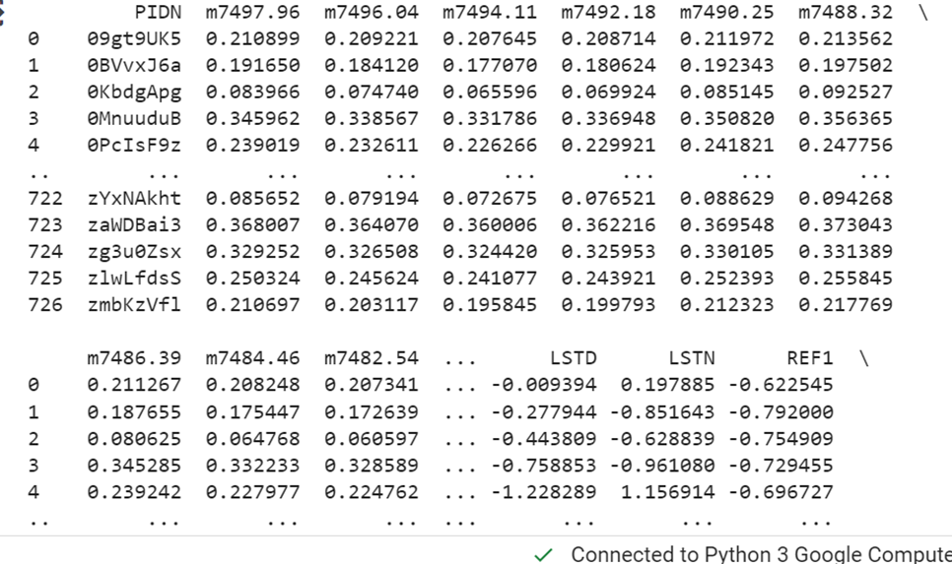
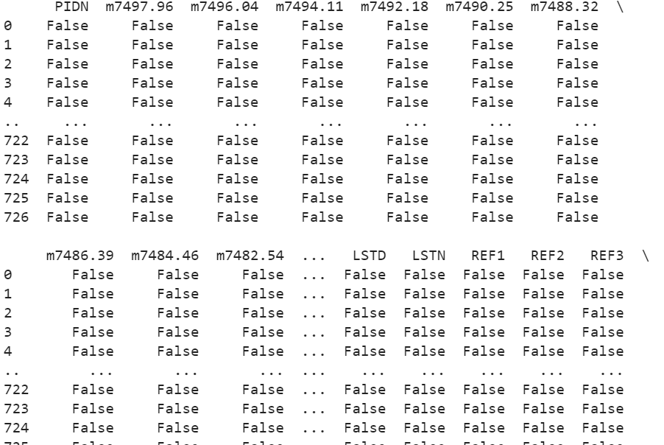
Data set:

Slide 5
IMPLEMENTATION Perceptron: A perceptron is a fundamental building block of artificial neural networks and serves as a simple model of a biological neuron. It was developed by Frank Rosenblatt in the late 1950s. A perceptron takes a set of binary inputs and produces a binary output based on a weighted sum of these inputs. It can be used for binary classification tasks where it learns to separate data points into two categories. Here's an explanation of the perceptron with its formula: Inputs: A perceptron takes multiple binary input values, denoted as x₁, x₂, x₃, ..., xᵢ. These inputs can be either 0 or 1. Weights: Each input is associated with a weight, denoted as w₁, w₂, w₃, ..., wᵢ. These weights are real numbers and represent the strength of the connection between the input and the perceptron. Weighted Sum: The weighted sum of the inputs is calculated as follows: Weighted Sum (Z) = w₁ * x₁ + w₂ * x₂ + w₃ * x₃ + ... + wᵢ * xᵢ network architectures.

Slide 6
LOGISTIC REGRESSION
Logistic regression is a statistical model used for binary classification tasks, where the goal is to predict one of two possible outcomes (e.g., 0 or 1, Yes or No, True or False) based on one or more input features.
Unlike linear regression, which predicts a continuous output, logistic regression predicts the probability of the binary outcome. It uses the logistic function (also called the sigmoid function) to model this probability.
Here's an explanation of logistic regression with its formula:
Formula: The logistic regression model calculates the probability (P) of a binary event (e.g., the probability of a positive outcome) using the logistic function:
z=w0+w1x1+w2x2----------------wnxn
yp=1/1+e^-z​
z=-Y LOG (YP)-(1-Y) LOG (1-YP)

Slide 7

K-NEAREST NEIGHBOURS(KNN)
K-Nearest Neighbors (K-NN) is a simple and effective machine learning algorithm used for both classification and regression tasks. It operates on the principle that similar data points are located near each other in a feature space. Here's how it works:
1. Training: K-NN doesn't have a traditional training phase. Instead, it memorizes the entire dataset, creating a reference for future predictions.
2. Prediction: To classify a new data point, K-NN calculates the distance (typically Euclidean distance) between the point and its K nearest neighbors in the training dataset.
3. Voting: For classification, it counts the number of data points in each class among the K neighbors. The class with the highest count becomes the predicted class. For regression, it averages the values of the K nearest neighbors.
4. Choosing K:The choice of K is a critical hyperparameter. A smaller K makes the model sensitive to noise
KNN to simple understand and implement.

Slide 8
BOOT STRAPPING
Resampling Method: Bootstrapping is a resampling method that involves generating multiple samples (called "bootstrap samples") from a single dataset. These samples are obtained by randomly selecting data points with replacement, meaning the same data point can appear in multiple samples.
Bootstrapping is a resampling technique widely used in statistics and machine learning to estimate various statistical properties and evaluate the performance of models. Here are some key points about bootstrapping:
Estimate Population Statistics: Bootstrapping is often used to estimate population statistics, such as the mean, variance, confidence intervals, and other parameters, without making strong assumptions about the underlying data distribution.
Parameter Estimation: It can be used to estimate parameters of a statistical model. For example, you can use bootstrapping to estimate coefficients of a linear regression model, which provides insights into the model's uncertainty.

Slide 9
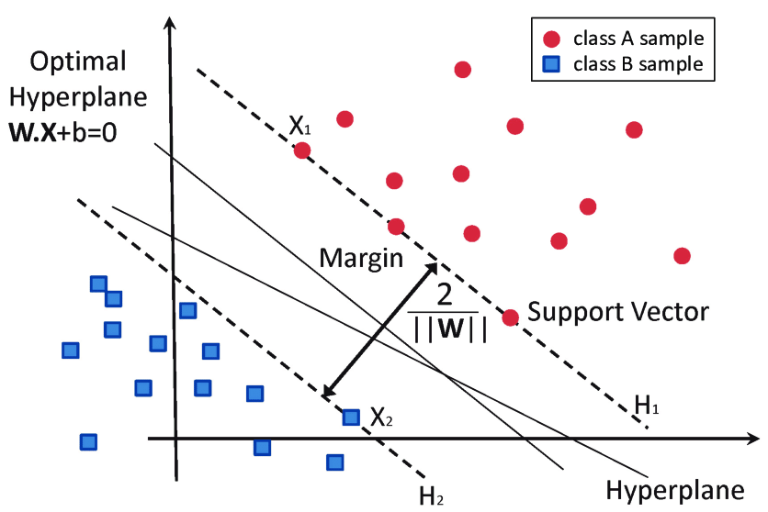
SUPPORT VECTOR MACHINE:
A Support Vector Machine (SVM) is a supervised machine learning algorithm that is used for classification and regression tasks. It is particularly effective in solving binary and multi-class classification problems. Here are some key points about Support Vector Machines:
Classification and Regression: SVM can be used for both classification and regression tasks. In classification, it separates data points into different classes, while in regression, it predicts a continuous numeric value.
Linear and Non-Linear Classification: SVM can perform linear classification by finding a hyperplane that best separates the data into different classes. It can also be extended to non-linear classification using techniques such as the kernel trick.
Margin Maximization: The key idea behind SVM is to find the hyperplane that maximizes the margin between the classes. The margin is the distance between the hyperplane and the nearest data points from each class.

Slide 10
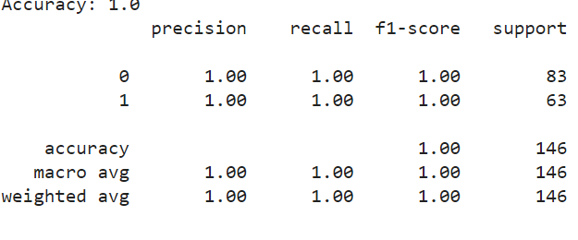
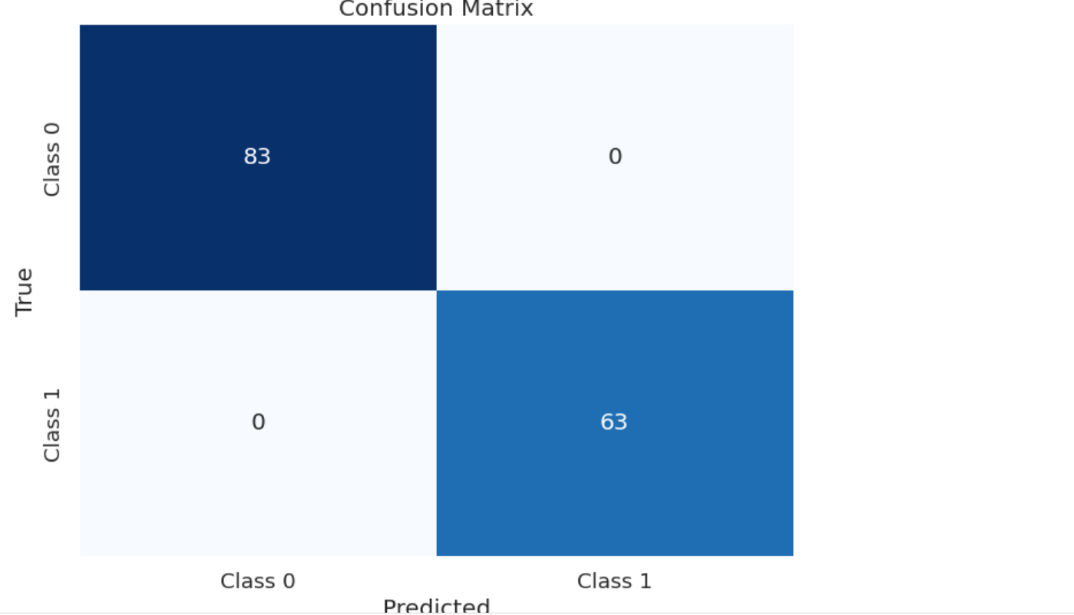
PERCEPTRON:

Slide 11
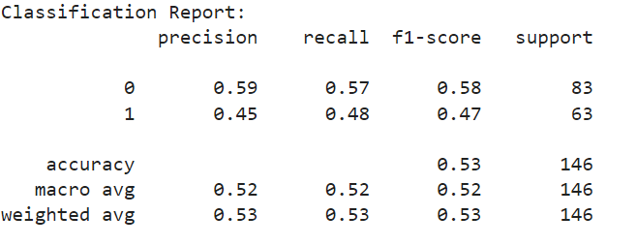
LOGISTIC REGRESSION
ACCURACY:

Slide 12
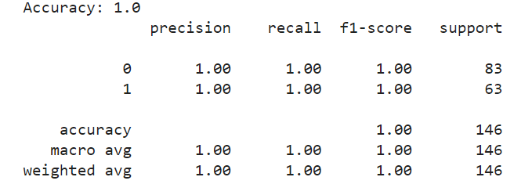
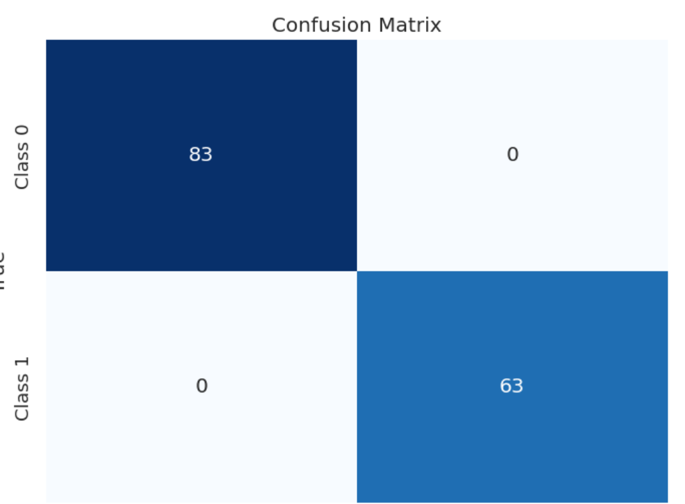
SUPPORT VECTOR MACHINE:
ACCURACY:
CONFUSION MATRIX:

Slide 13
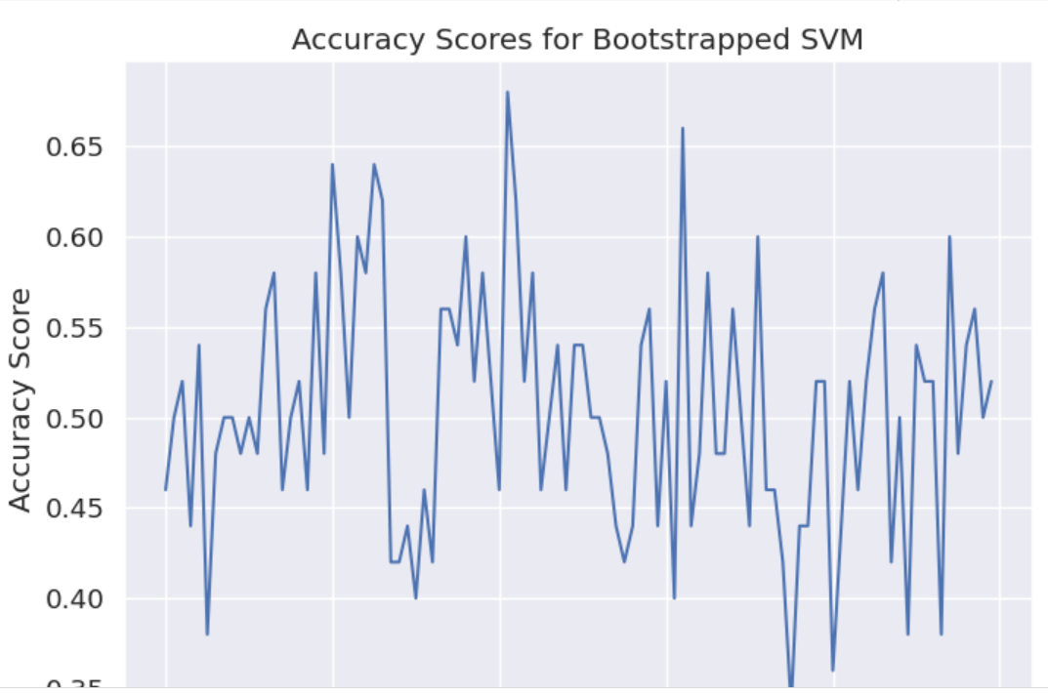
BOOT STRAPPING:

Slide 14
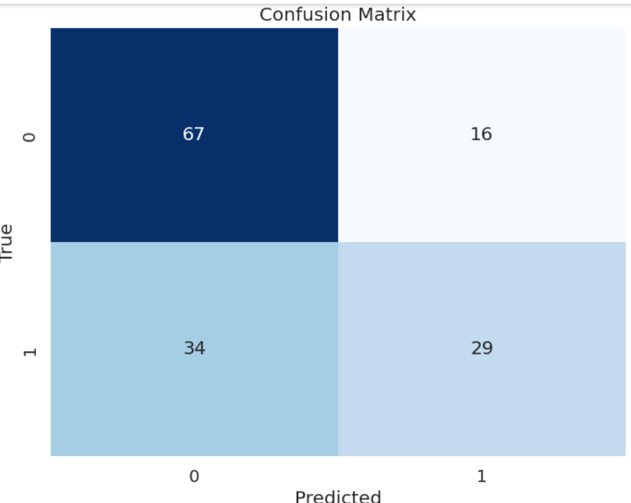
KNN:

Slide 15
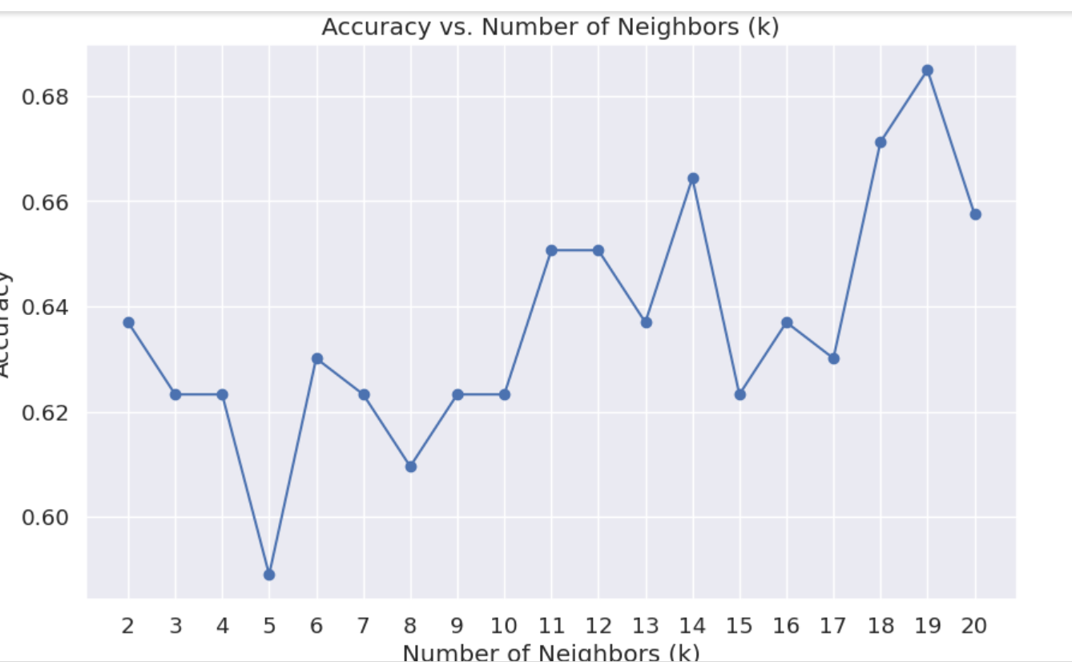
BOOT STRAPPING:

Slide 16
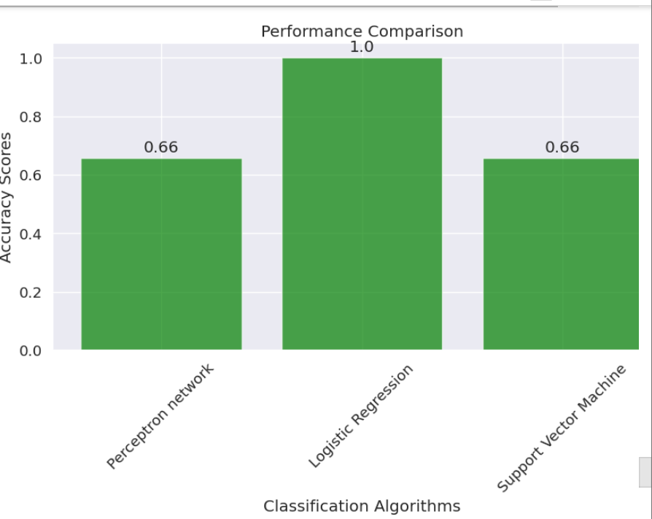
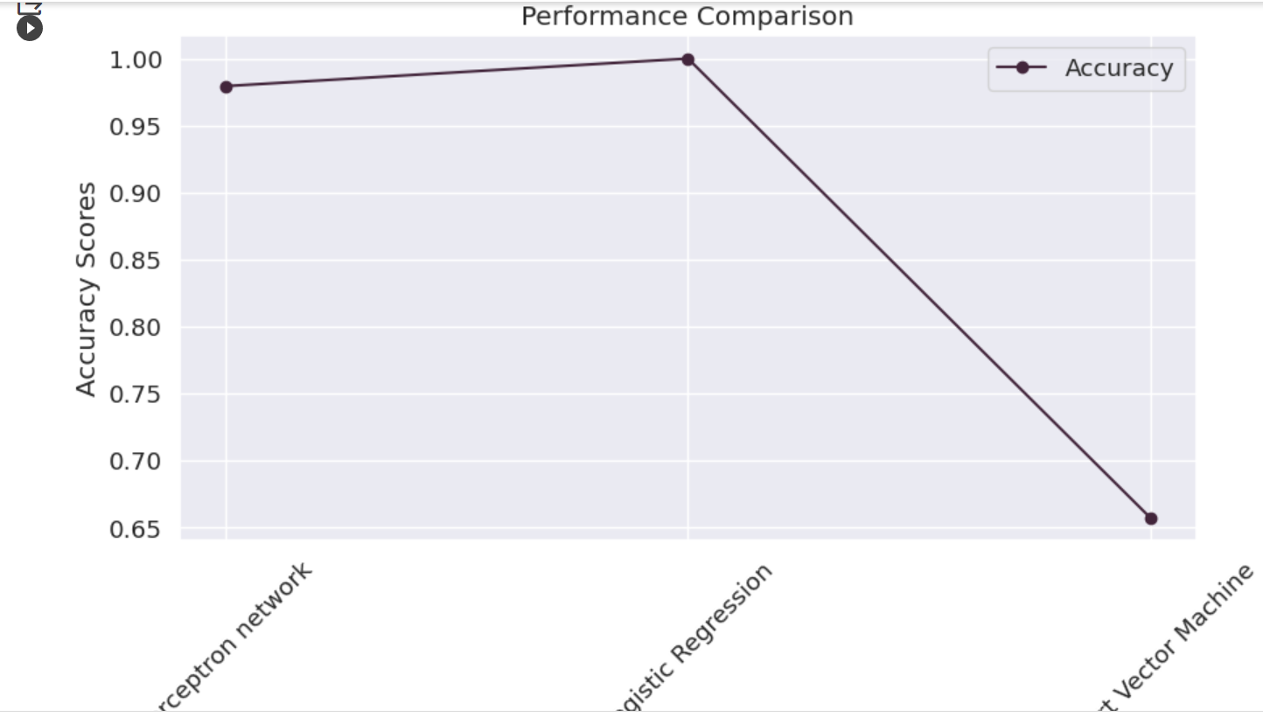
GRAPHS:

Slide 17
ANALYSIS:
By observing the above accuracy we can analyze that perceptron learning and logistic regression doesn't have perfect confusion matrix. For perfect confusion matrix the left diagonal numbers should be greater than right diagonal numbers in a matrix. By this statement the perception learning and logistic regression doesn't have confusion matrix. But for support vector machine the confusion matrix is very perfect so the best fit will come by using support vector machine

Slide 18
CONCLUSION:
SOIL PREDICTION USING MACHINE LEARNING ALGORITHMS EMPOWERS FARMERS WITH INSIGHTS FOR SUSTAINABLE AGRICULTURE,PRECISE FERTILIZATION AND OPTIMAL CROP MANAGEMENT .UNLEASH THE POTENTIAL OF SOIL TODAYY!!!!

Slide 19
GITHUB LINK:
https://github.com/Shravaniguguloth/2203a52235.review2

